Slide 1
Registers and Counters

Slide 2
Overview
Parallel Load Register
Shift Registers
  Serial Load
  Serial Addition
Shift Register with Parallel Load
Bidirectional Shift Register
Counters
  Synchronous
  Ripple

Slide 3
Registers and Counters
An n-bit register = n flip-flops arranged to work together
Capable of storing n bits of binary information

Slide 4
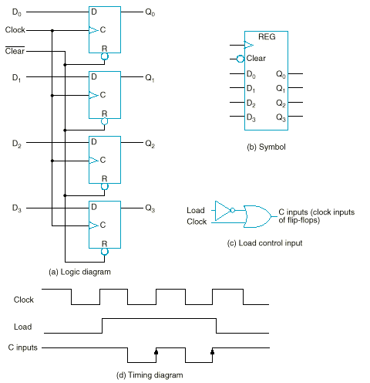
4-Bit Register (w/ clock gating)

Slide 5
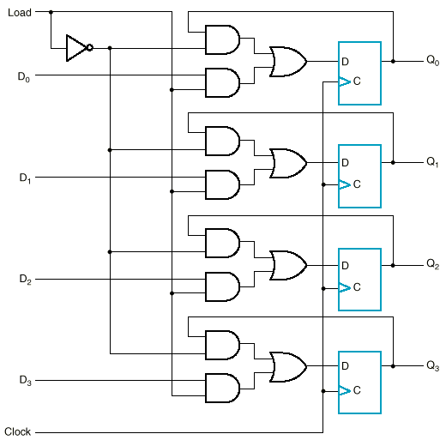
4-Bit Register (w/o clock gating)

Slide 6
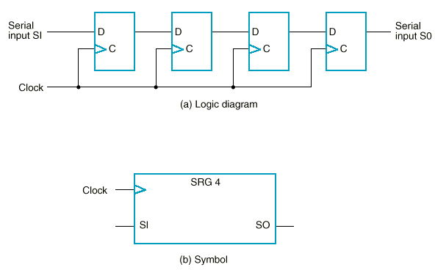
Shift Register

Slide 7
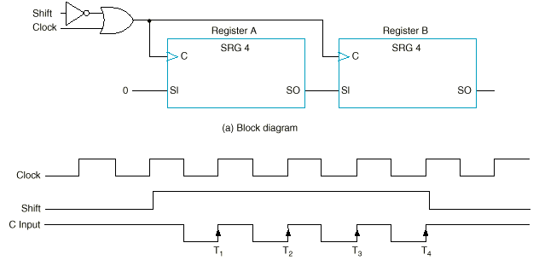
Serial Data Transfer
Serial transfer of information from register A to register B

Slide 8
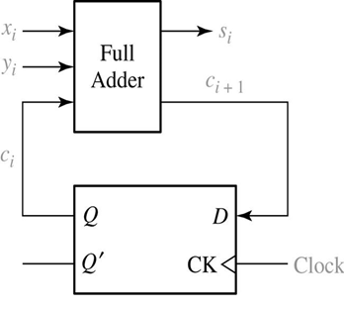
Serial Addition Using Shift Registers
The two binary numbers to be added serially are stored in two shift registers.
The sum bit on the S output of the full adder is transferred into the result register A.
Si Shift Reg. x So
Si Shift Reg. A So
Si Shift Reg. y So
Clock
Clock

Slide 9
Serial vs. Parallel Addition
The parallel adder is a combinational circuit, whereas the serial adder is a sequential circuit.
The parallel adder has n full adders whereas the serial adder requires only one full adder.
The serial circuit takes n clock cycles to complete an addition.
The serial adder, although it is n times slower, is n times smaller in space.

Slide 10
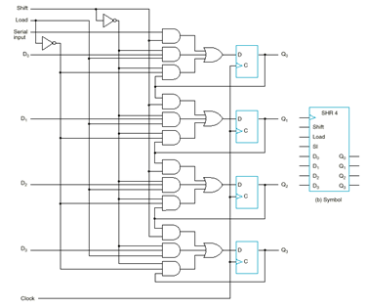

Shift Register with Parallel Load

Slide 11
Shift Register with Parallel Load (unidirectional)
Shift | Load | Operation
0 | 0 | Nothing
0 | 1 | Load parallel
1 | X | Shift Q0 → Q1, Q1→Q2…

Slide 12
Shift Register with Parallel Load (bidirectional)
S₁S₀ | Action
00 | Nothing
01 | Shift down
10 | Shift up
11 | Parallel load

Slide 13
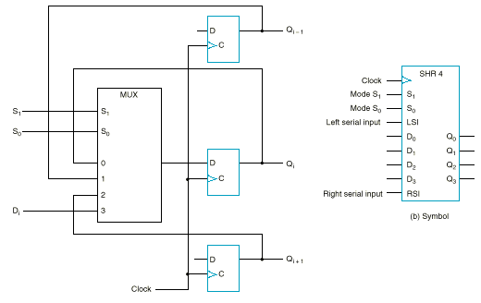
Bidirectional Shift Register
Note: For simplicity, only one MUX is shown. Each FF needs its own MUX!
S₁S₀ | Action
00 | Nothing
01 | Shift down
10 | Shift up
11 | Parallel load

Slide 14
Counters
A counter is a sequential circuit that goes through a predetermined sequence of states upon the application of clock pulses.
Counters are categorized as:
  Synchronous Counters:
  All FFs receive a common clock pulse, and the change of state is determined from the present state.
  Ripple Counters:
  One FF output transition serves as a source for triggering other FFs. No common clock.

Slide 15
Synchronous Binary Counters
The design procedure for a binary counter is the same as any other synchronous sequential circuit.
Most efficient implementations usually use T-FFs or JK-FFs. We will examine JK and D flip-flop designs.

Slide 16
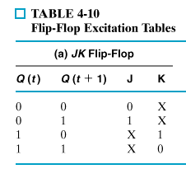
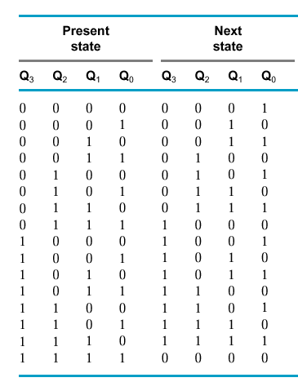
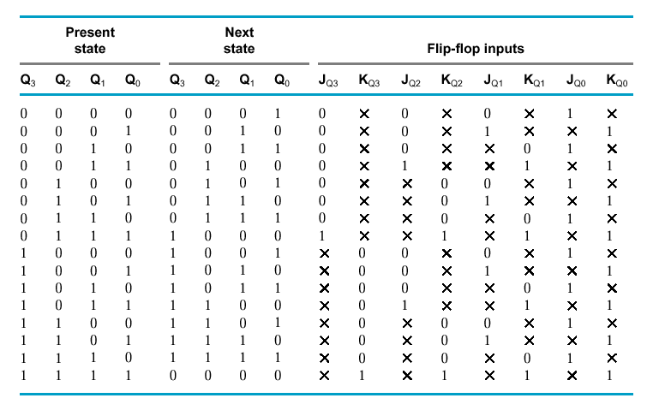
Synchronous Binary Counters: JK FF Implementation

Slide 17
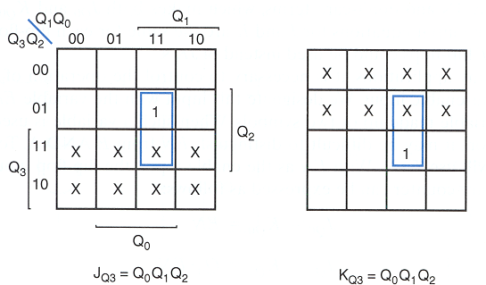
Synchronous Binary Counters: JK FF Implementation (Cont’d)

Slide 18
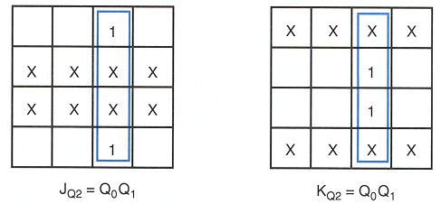
Synchronous Binary Counters: JK FF Implementation (Cont’d)

Slide 19
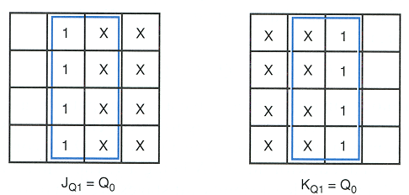
Synchronous Binary Counters: JK FF Implementation (Cont’d)

Slide 20
Synchronous Binary Counters: JK FF Implementation (Cont’d)
logic 1
Q₀
J
J_{Q0} = 1
K_{Q0} = 1
J_{Q1} = Q₀
K_{Q1} = Q₀
J_{Q2} = Q₀ Q₁
K_{Q2} = Q₀ Q₁
J_{Q3} = Q₀ Q₁ Q₂
K_{Q3} = Q₀ Q₁ Q₂
C
K
J
Q₁
C
K
J
Q₂
C
K
J
Q₃
C
K
CLK
20

Slide 21
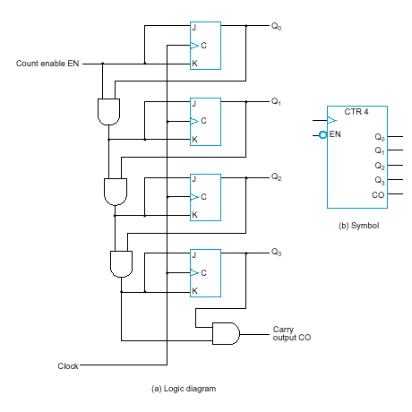
Synchronous Binary Counters: JK FF Implementation with EN and CO
EN = enable control signal, when 0, counter remains in the same state, when 1, it counts
CO = carry output signal, used to extend the counter to more stages
J_{Q0} = 1 · EN
K_{Q0} = 1 · EN
J_{Q1} = Q₀ · EN
K_{Q1} = Q₀ · EN
J_{Q2} = Q₀ Q₁ · EN
K_{Q2} = Q₀ Q₁ · EN
J_{Q3} = Q₀ Q₁ Q₂ · EN
K_{Q3} = Q₀ Q₁ Q₂ · EN
C0 = Q₀ Q₁ Q₂ Q₃ · EN

Slide 22
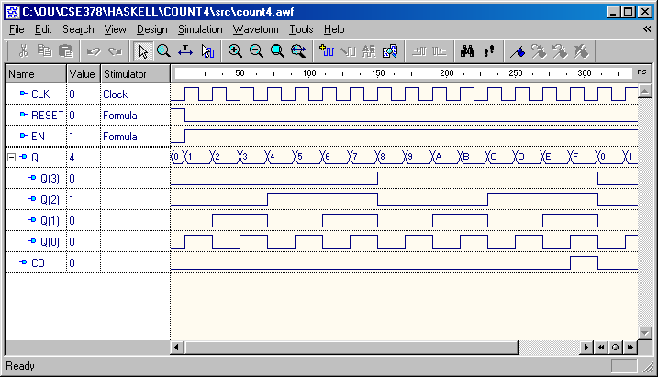
4-bit Upward Synchronous Binary Counter in HDL - Simulation
PJF<number>

Slide 23
Counter with Parallel Load
Design a path for input data
  enabled if Load = 1
Design some logic to:
  disable count logic when Load = 1
  disable feedback from outputs
  when Load = 1
  hold the stored value when Load = 0
  and Count = 0
  enable count logic when Load = 0
  and Count = 1
The resulting function table:
Load
Count
D
0
D
Q
0
C
D
1
D
Q
1
C
D
2
D
Q
2
Load | Count | Action
0 | 0 | Hold Stored Value
0 | 1 | Count Up Stored Value
1 | X | Load D
C
D
3
D
Q
3
C
Carry
Clock
Output CO

Slide 24
Counting Modulo 7: Detect 7 and Asynchronously Clear
In this figure, a synchronous 4-bit binary counter
with an asynchronous Clear is
used to make a Modulo
7 counter.
It uses the Clear feature to
detect the count 7 and
clear the count to 0. This
gives a count of 0, 1, 2, 3, 4,
5, 6, 7(short)0, 1, 2, 3, 4, 5,
6, 7(short)0, etc.
D3
Q3
D2
Q2
D1
Q1
D0
Q0
Clock
CP
0
LOAD
CLEAR
Do NOT do this because count “7” shows up momentarily!

Slide 25
Counting Modulo 7: Synchronously Load on Terminal Count of 6
A synchronous 4-bit binary
counter with a synchronous
load and an asynchronous
clear is used to make a
Modulo 7 counter
Use the Load feature to
detect the count "6" and
load in "zero". This gives
a count of 0, 1, 2, 3, 4, 5, 6,
0, 1, 2, 3, 4, 5, 6, 0, ...
Using don’t cares for states
above 0110, detection of 6 can be done with Load = Q2.Q1
0
D3
Q3
0
D2
Q2
0
D1
Q1
0
D0
Q0
Clock
CP
LOAD
Reset
CLEAR

Slide 26
Counting Modulo 6: Synchronously Preset 9 on Reset and Load 9 on Terminal Count 14
1
D3
Q3
0
D2
Q2
A synchronous, 4-bit binary
counter with a synchronous
Load is to be used to make a
Modulo 6 counter.
Use the Load feature to
preset the count to 9 on
Reset and detection of
count 14.
This gives a count of 9, 10, 11, 12, 13, 14, 9, 10, 11, 12, 13, 14, 9, …
If the terminal count is 15, detection is usually built in as Carry Out (CO)
0
D1
Q1
1
D0
Q0
Clock
CP
Reset
LOAD
1
CLEAR

Slide 27
Ripple Counter Concept
Toggles at every clock
Toggles every 2 clocks
Toggles every 8 clocks
Toggles every 4 clocks

Slide 28
Ripple Counter
A 2-bit binary counter
How does it work?
  When there is a positive
  edge on the clock input
  of A, A toggles
  The clock input for flip-
  flop B is the complemented
  output of flip-flop A
  When flip-flop A changes
  from 1 to 0, there is a
  positive edge on the
  clock input of B
  causing B to
  toggle
D
A
Clock
C_{R}
D
B
C_{R}
Reset
CP
A
B
0
1
2
3
0
1

Slide 29
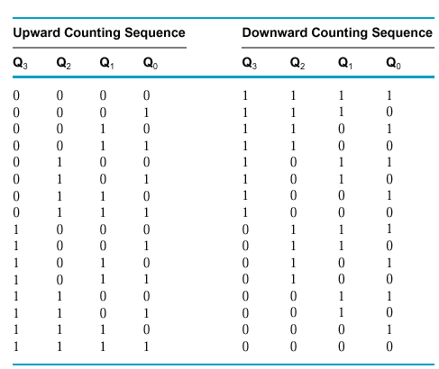
Example (Cont’d)
The main idea is that:
  Q₀ toggles at half the clock rate
  Q₁ toggles at half Q₀ rate
  Q₂ toggles at half Q₁ rate
  And so on…

Slide 30
Ripple Counter (Cont’d)
The arrows show the
cause-effect relation-
ship from the prior
slide =>
The corresponding
sequence of states =>
(B,A) = (0,0),
CP
A
B
0
1
2
3
0
1
(0,1),
(1,0),
(1,1),
(0,0),
(0,1), …
Each additional bit, C, D, …behaves like bit B, changing half as frequently as the bit before it.
For 3 bits: (C,B,A) = (0,0,0), (0,0,1), (0,1,0), (0,1,1),
(1,0,0), (1,0,1), (1,1,0), (1,1,1), (0,0,0), …

Slide 31
Ripple Counter (Cont’d)
Starting with C = B = A = 1, equivalent to (C,B,A) = 7 base 10, the next clock increments the count to (C,B,A) = 0 base 10. In fine timing detail:
  The clock to output delay
  t_{PHL} causes an increasing
  delay from clock edge for
  each stage transition.
  Thus, the count “ripples”
  from least to most
  significant bit.
  For n bits, total worst case
  delay is n t_{PHL}.
t_{PHL}
CP
t_{PHL}
A
t_{pHL}
B
C

Slide 32
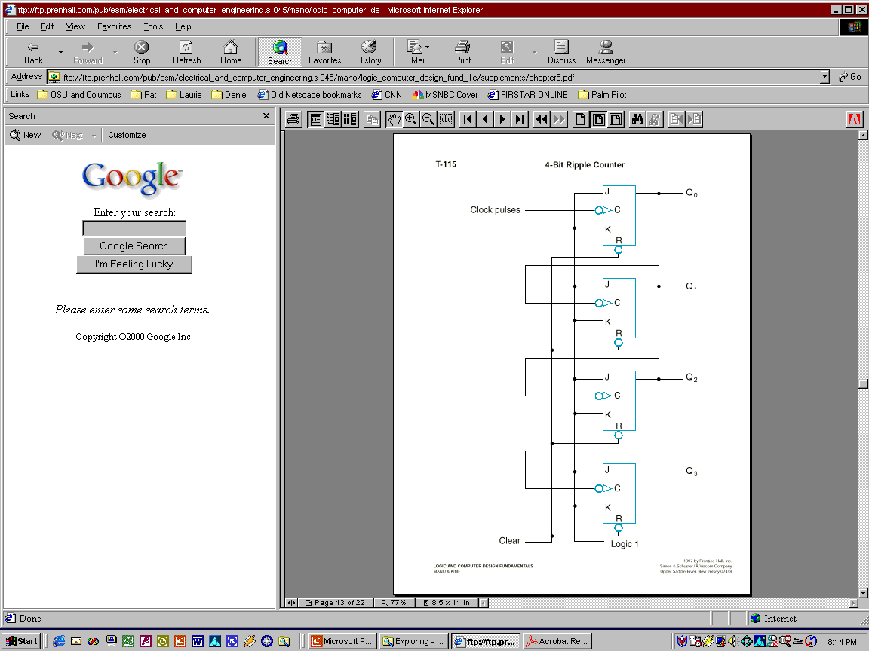
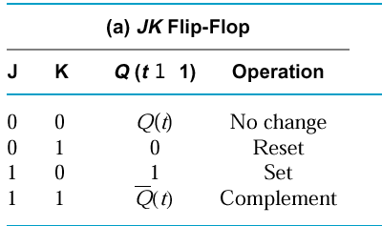
Example: A 4-bit Upward
Counting Ripple Counter
Less Significant
Bit output is Clock
for Next Significant Bit!
(Clock is active low)
Recall...

Slide 33
A 4-bit Downward
Counting Ripple Counter
Use direct Set (S) signals instead of direct Reset (R), in order to start at 1111.
Alternative designs:
  Change edge-triggering to positive
  Connect the complement output of each FF to the C input of the next FF in the sequence.

Slide 34
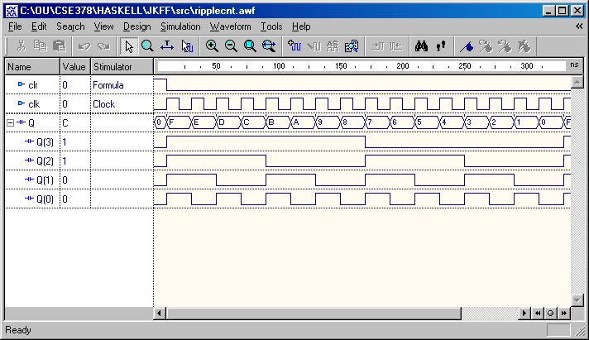
Simulation …
P3<number>

